Slide 1

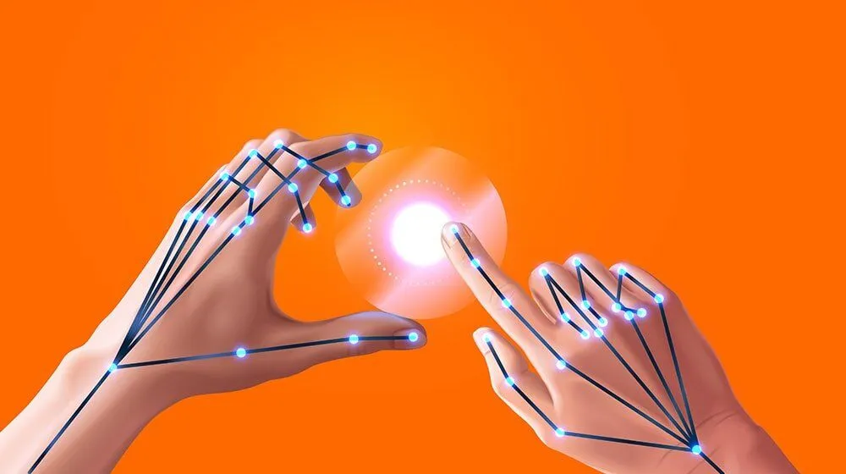
Hand Gesticulation
(using React)
SUBMITTED BY- SUBMITTED TO- MONISHKA SINGH PARUL CHOUDHARY
DISHA AGRAWAL (ASSISTANT PROFESSOR, GLAU)
DEEPA AGRAWAL

Slide 2
INTRODUCTION
WHAT ARE GESTURES
Non- Verbal Communication
Gives Message
A gesture is a way of communicating with people without engaging any verbal forms of language
Its widely used nowadays
The advancements in machine learning and data science have made this easier

Slide 3
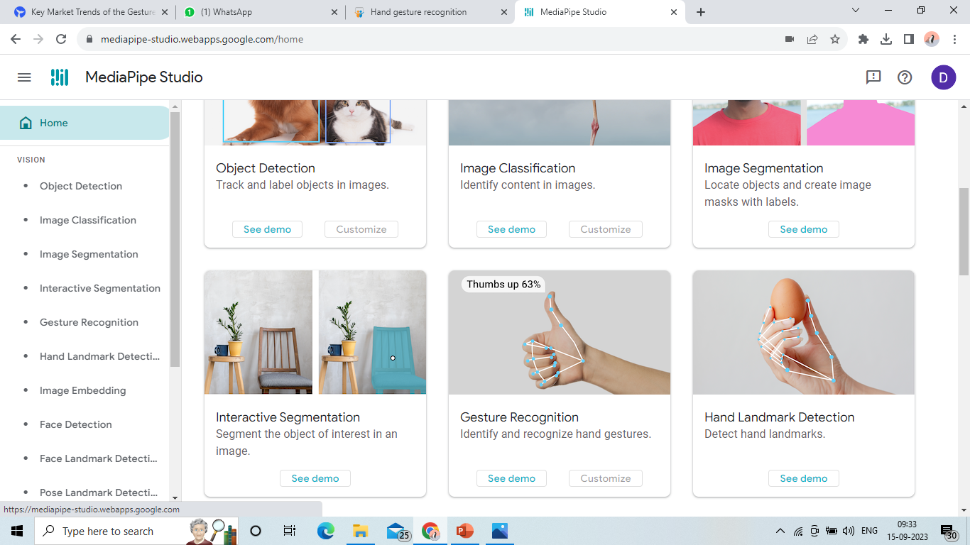
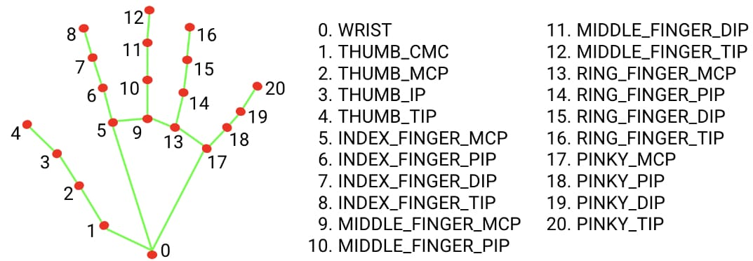
Hand-Gesture Recognition
Doing manual feature extraction using statistical functions of React.
These features were evaluated in classifiers such as SOFTMAX, ANN and SVM.
The best performing model was the combination of BiLSTM and ANN with 99.9912% accuracy
MediaPipe offers a hand tracking model that can provide hand landmark coordinates.

Slide 4
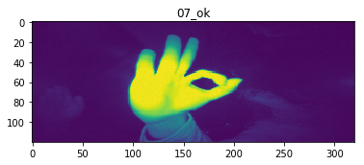
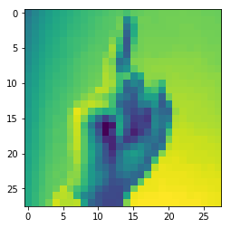
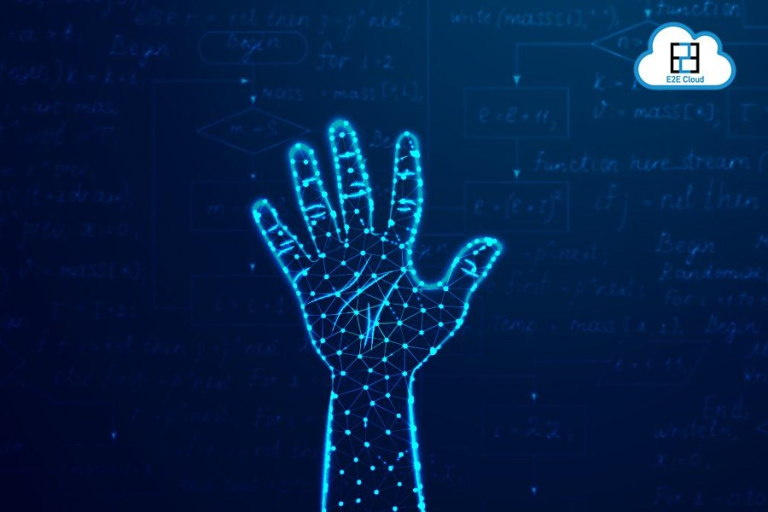
Available Datasets
Hand Gesture Recognition Database with CNN | Accuracy : 99. 95%
Hand gesture recognition using tensor-flow | Accuracy : 96.86%
Hand Gesture recognition using Support Vector Machine (SVM) | Accuracy : >90%

Slide 5
THANK YOU

